Slide 1
Bioinformatics internship
Class two

Slide 2



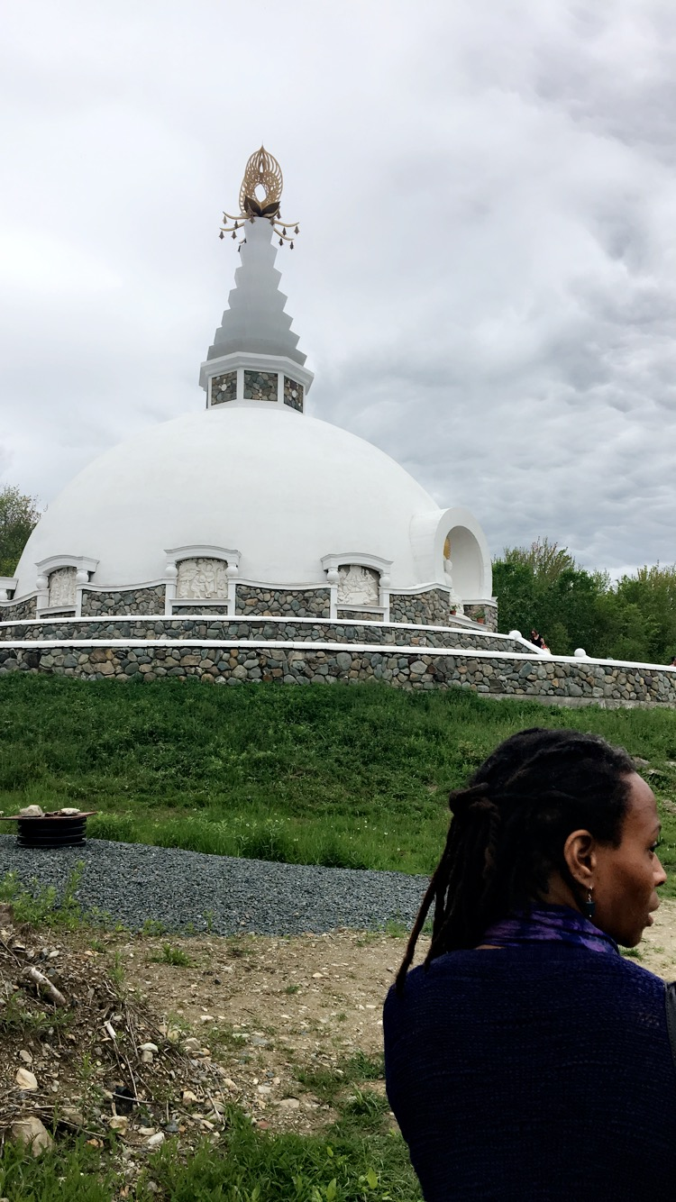
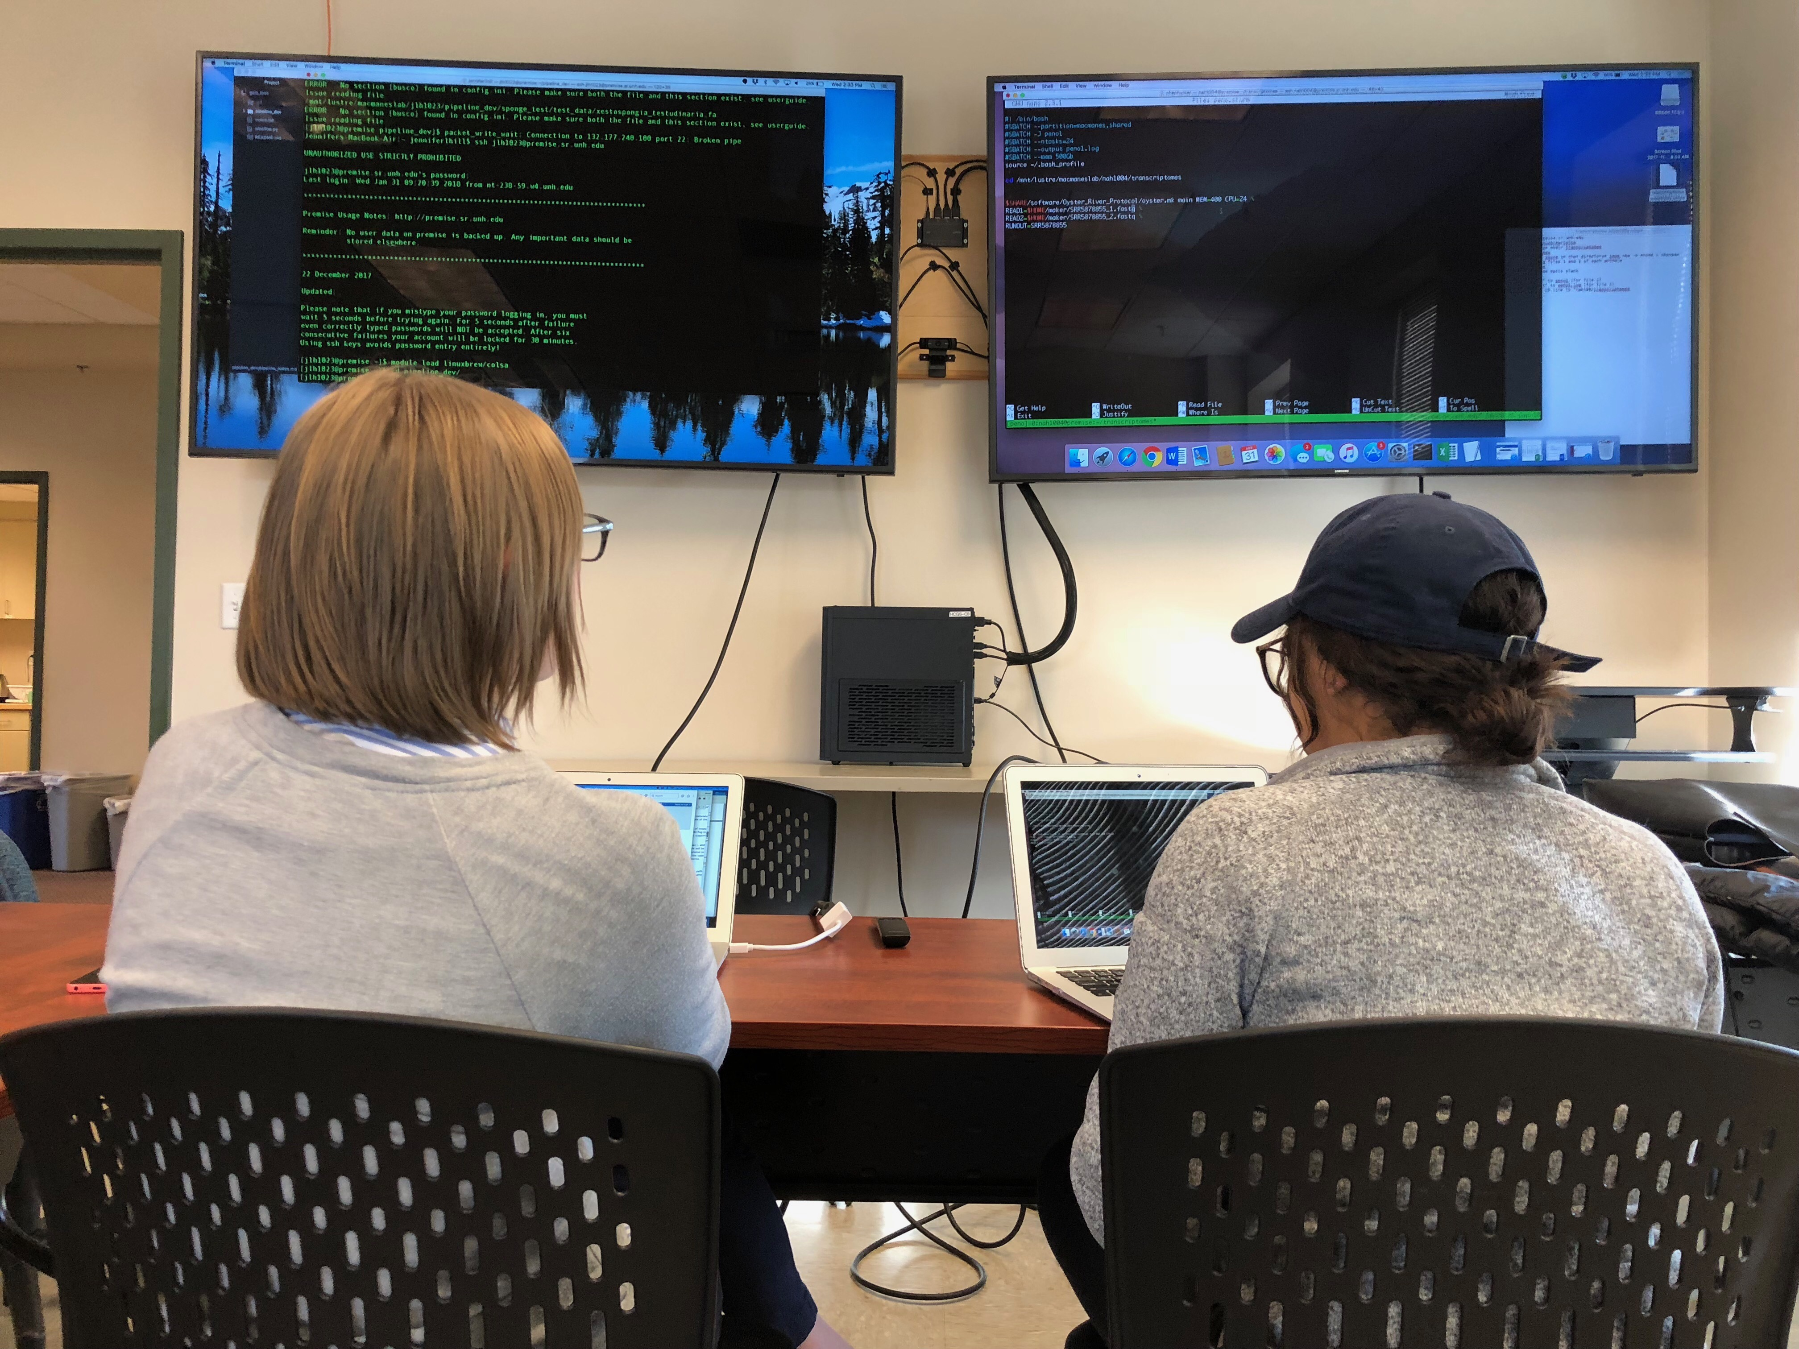
About nhen

Slide 3
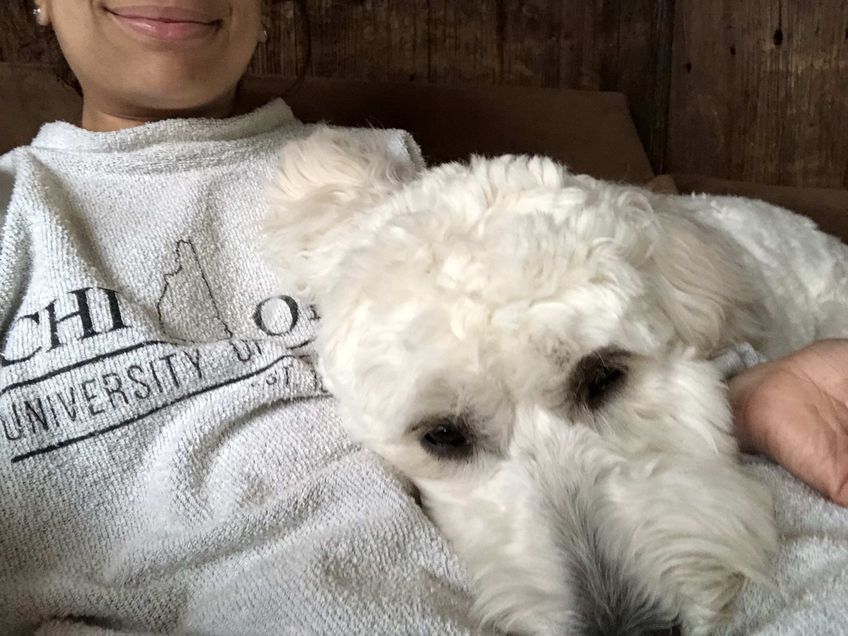
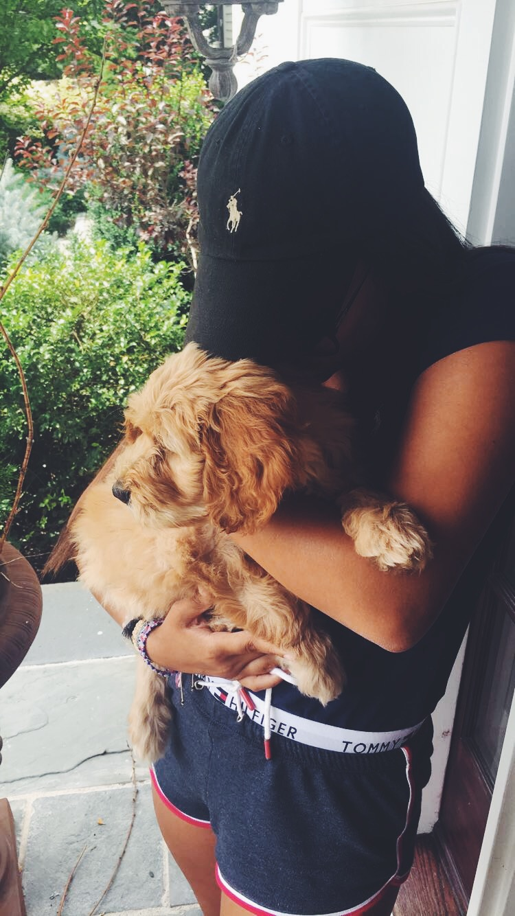
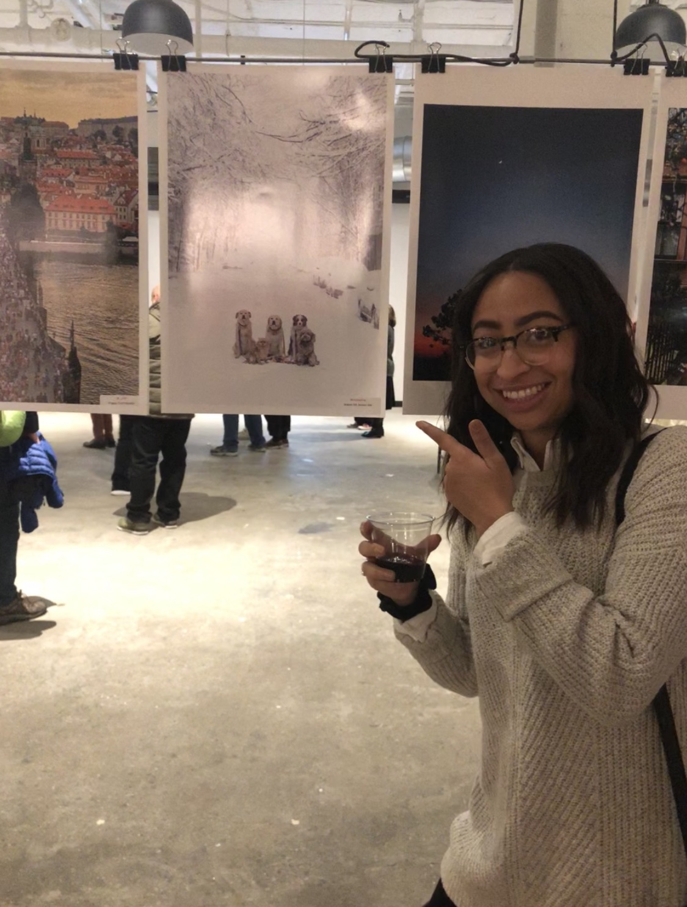
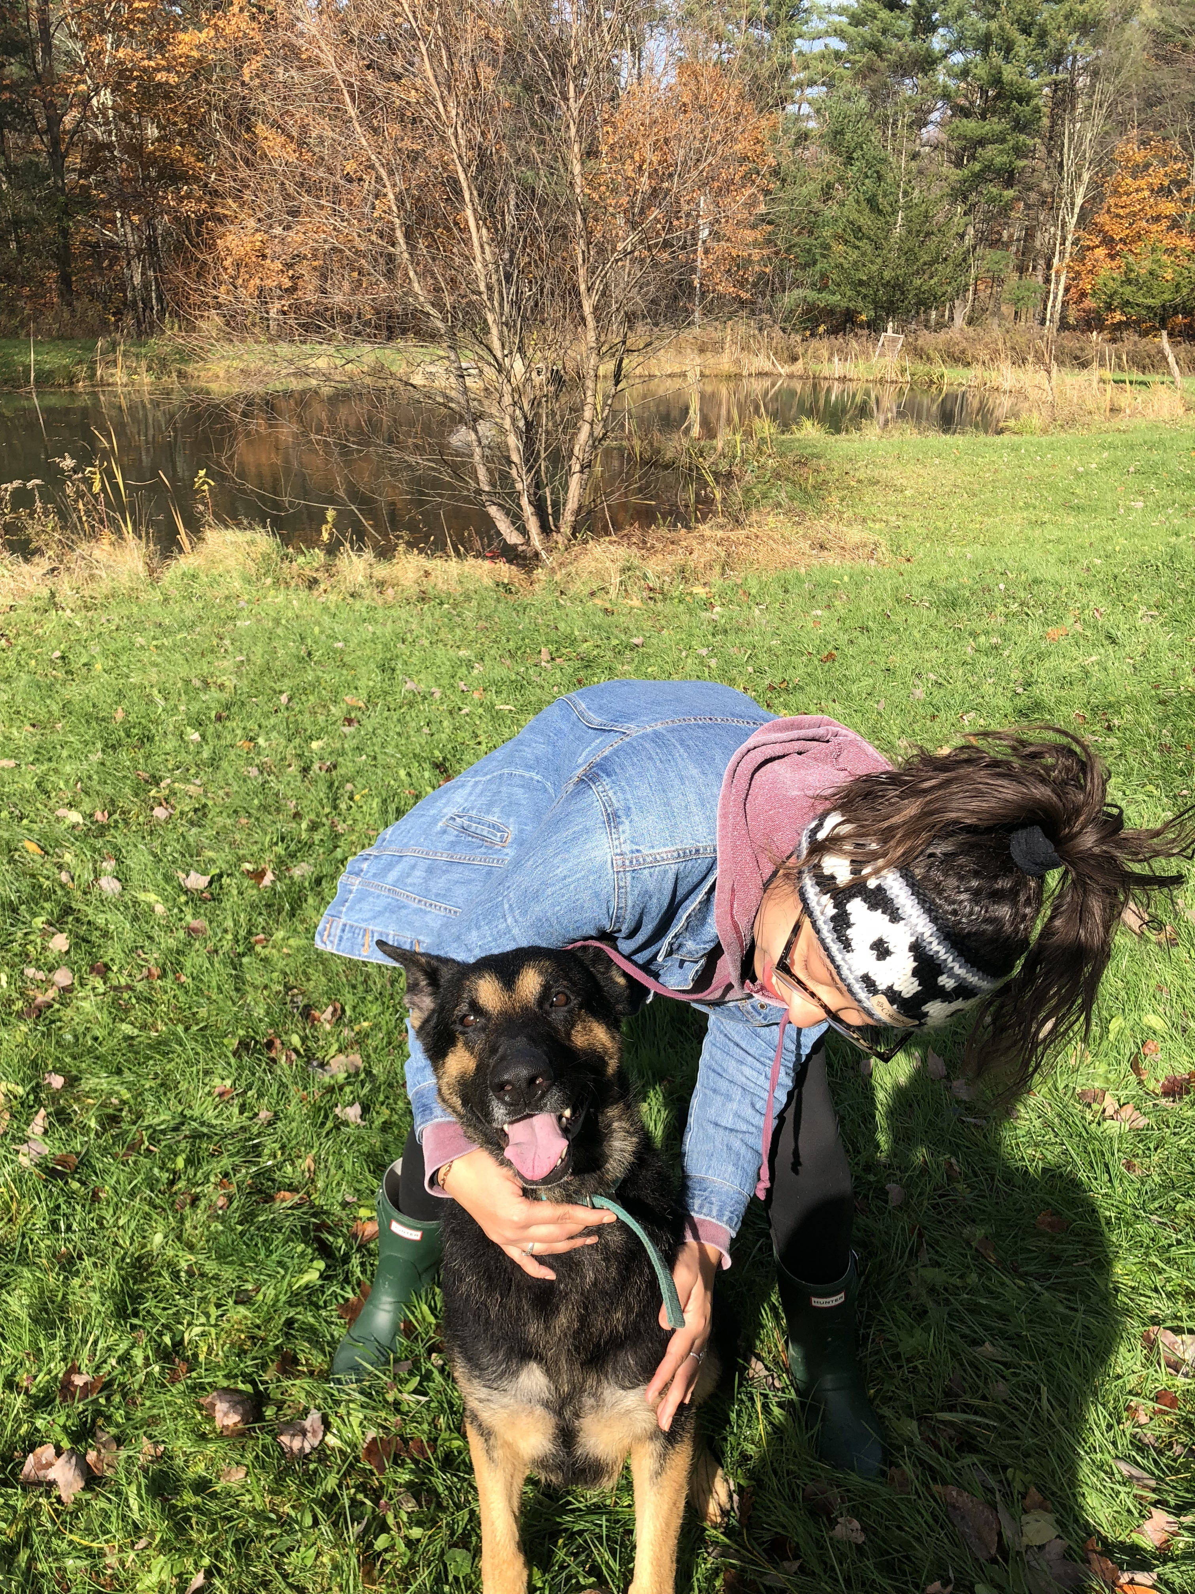
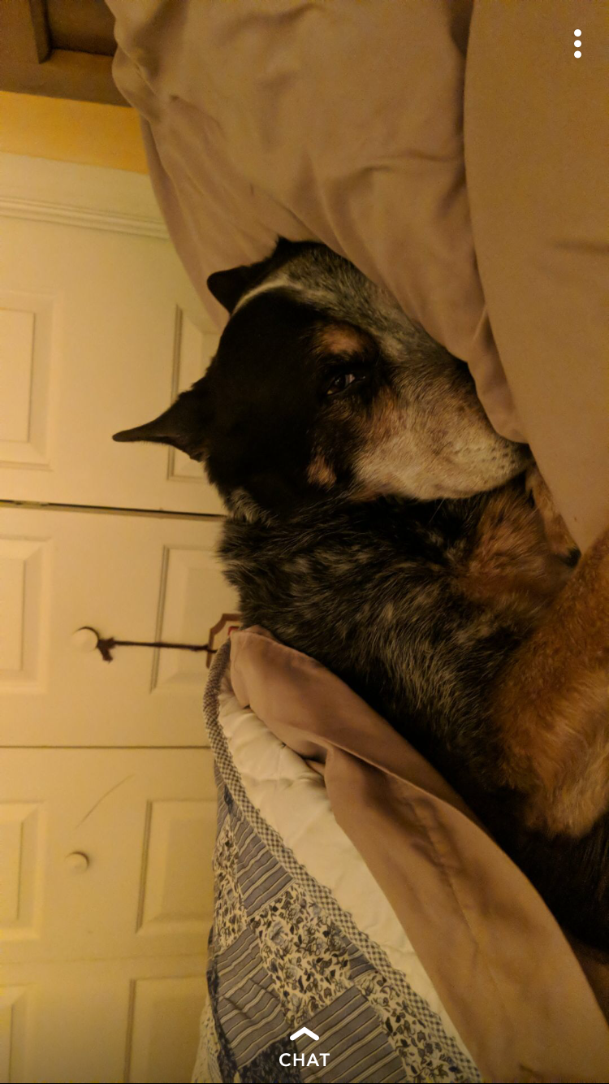
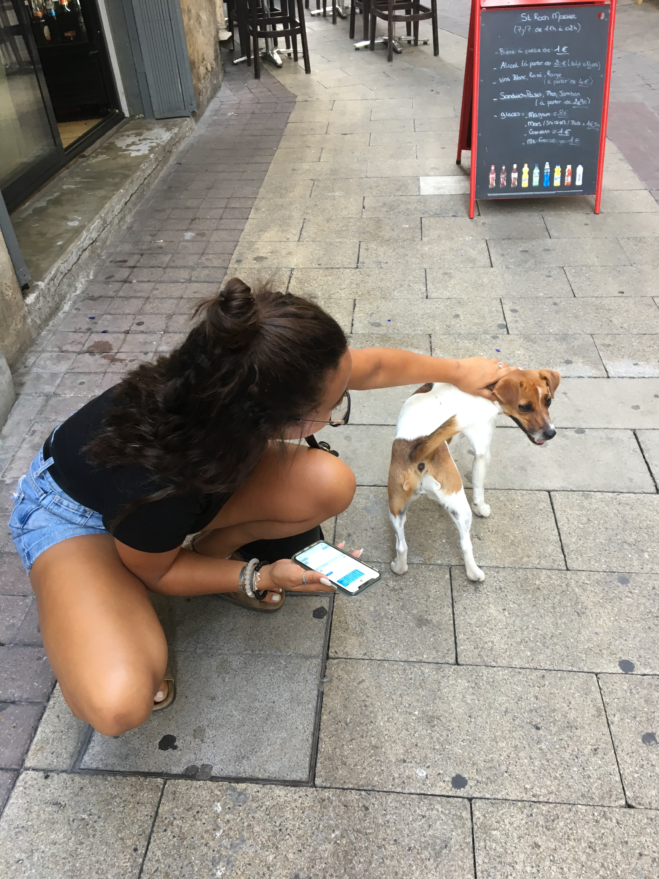
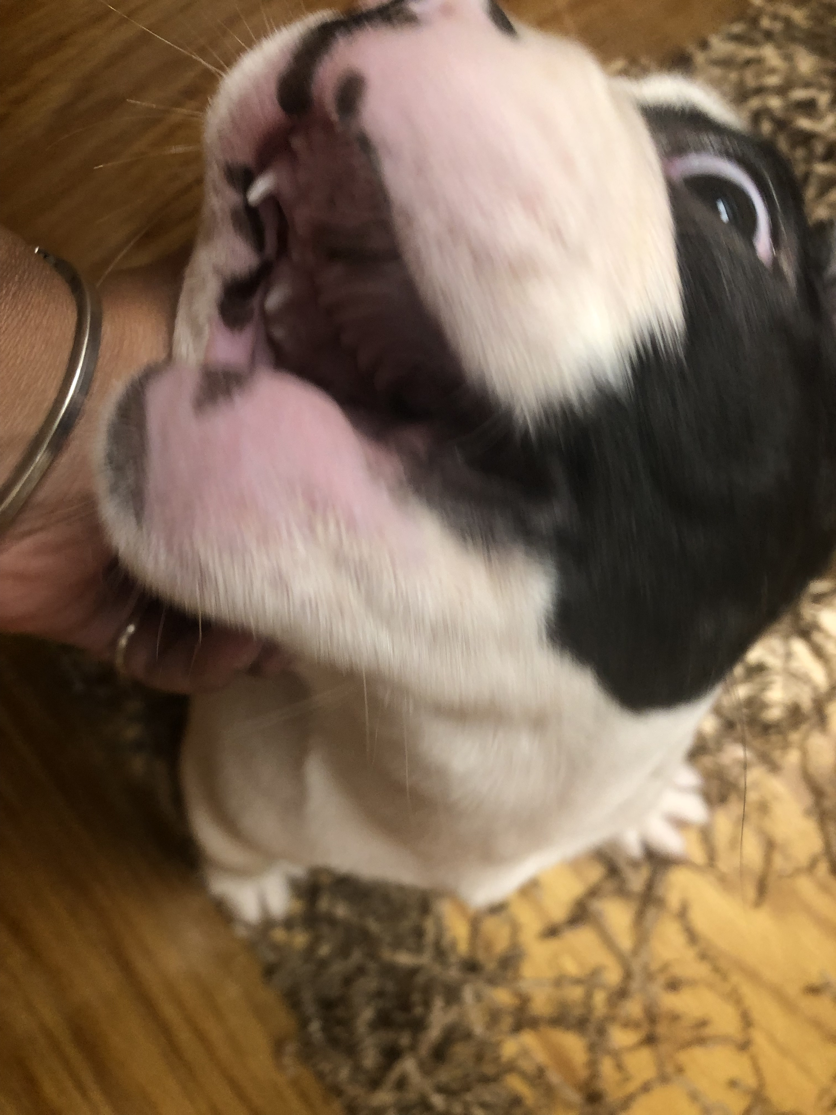
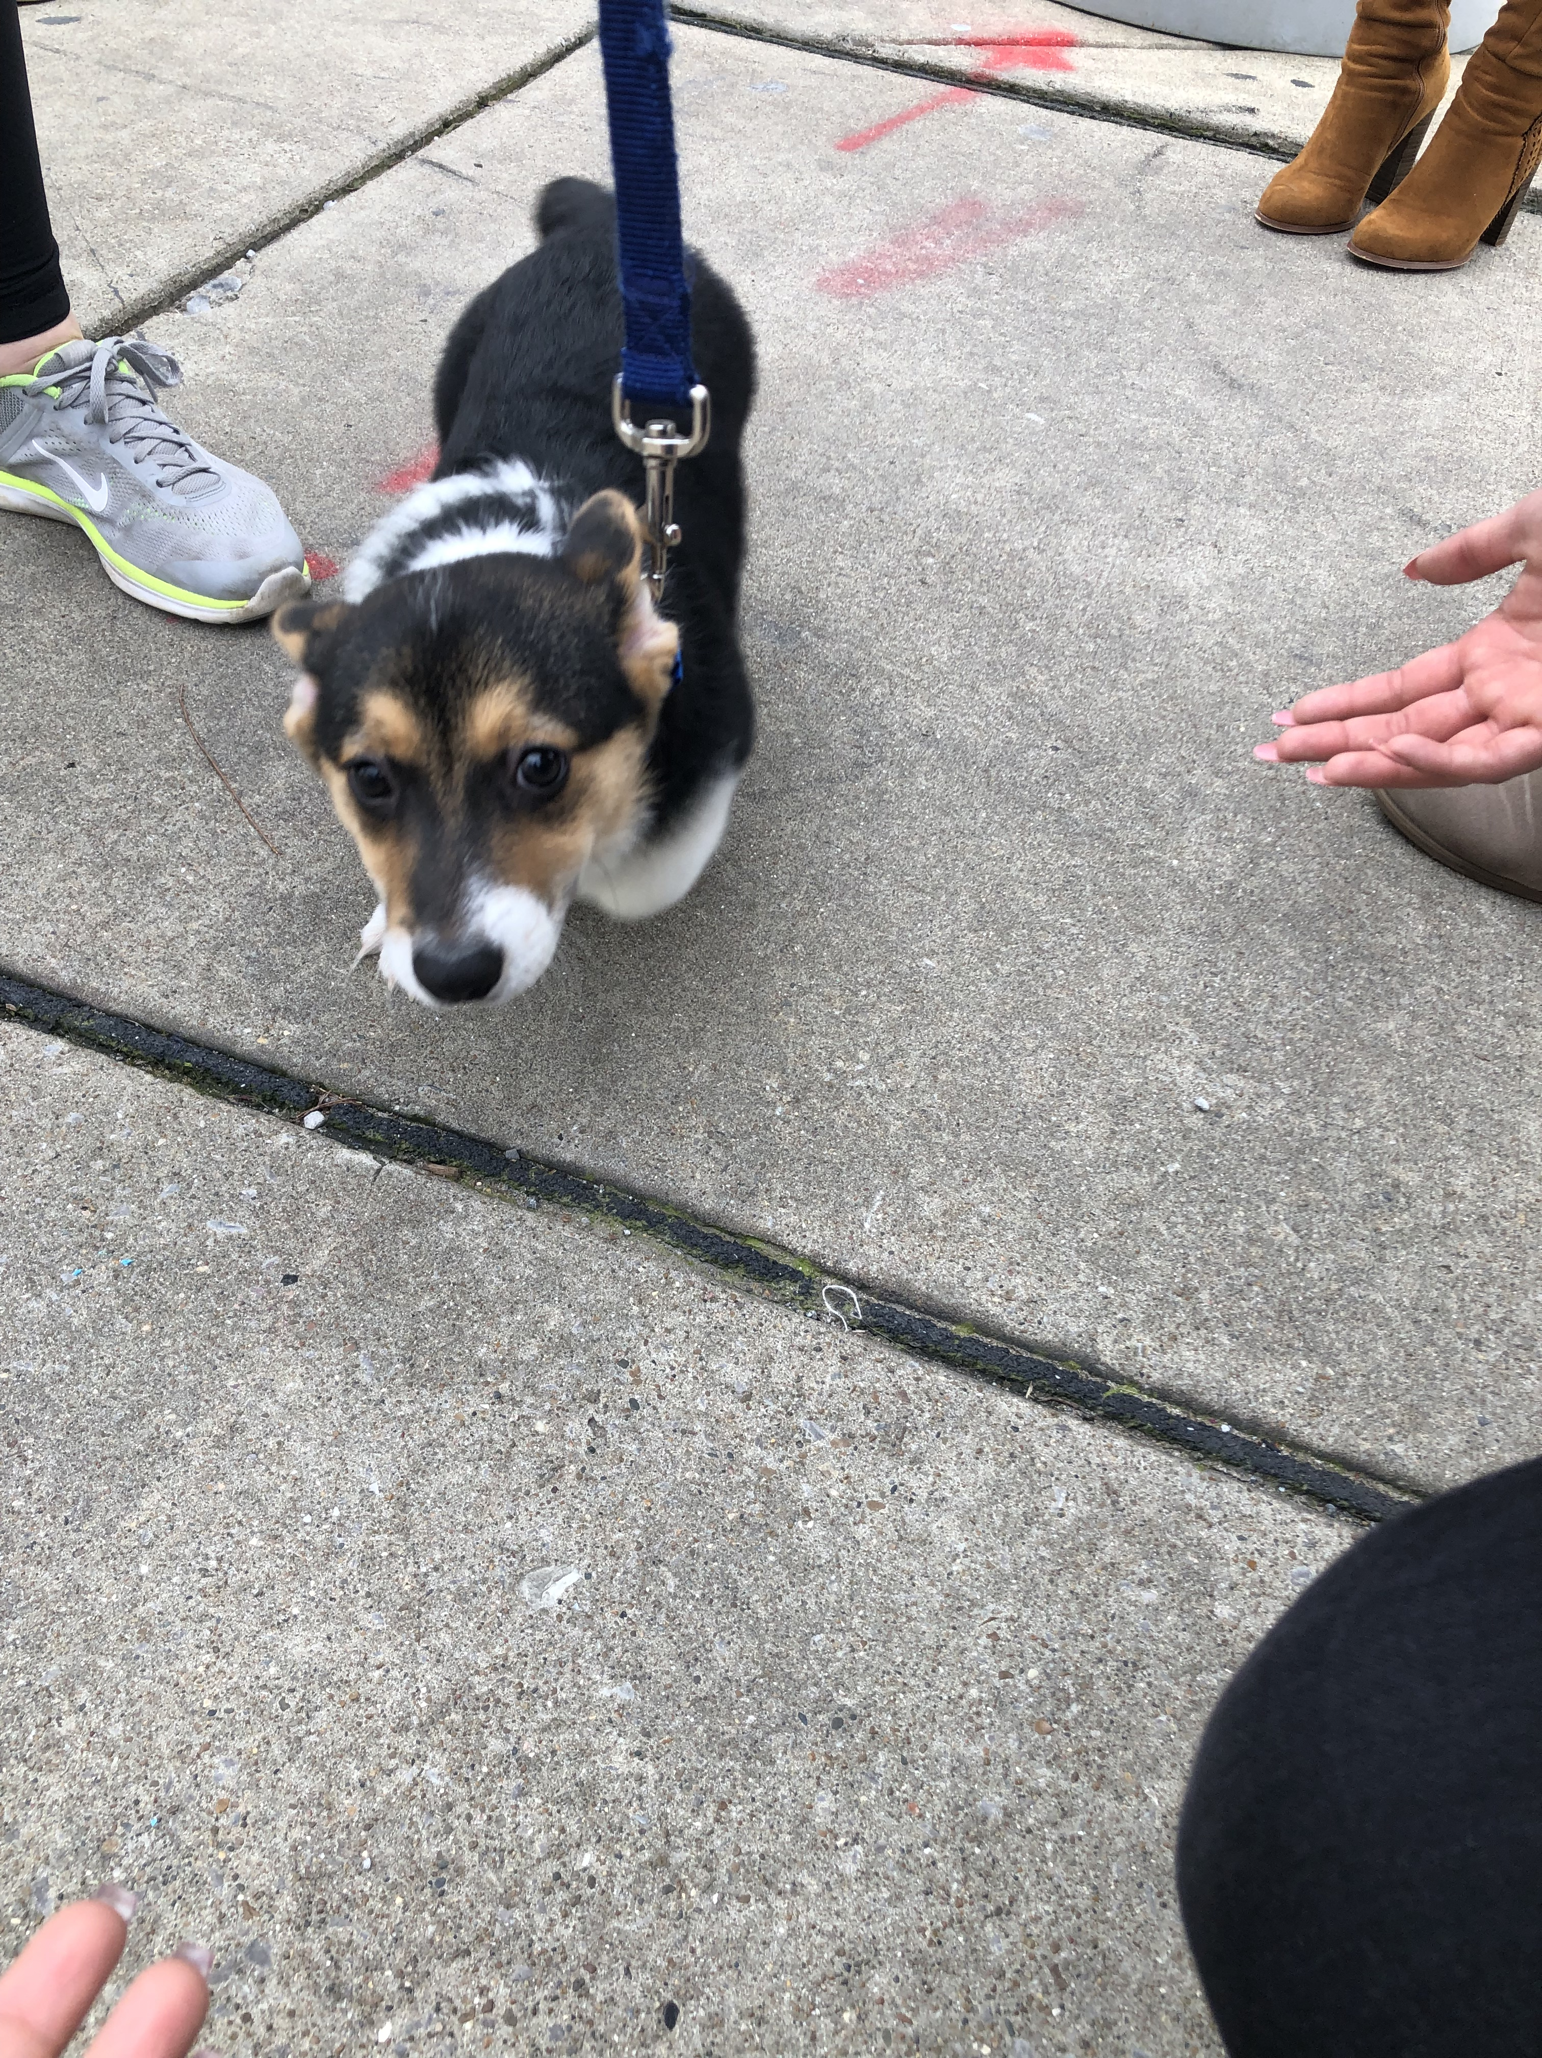

Slide 4
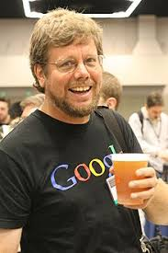
Bioinformatic fun fact
“Python” was named, by its creator Guido Van Rossum, after one of his favorite movies Monty Python
https://m.youtube.com/watch?v=886hNDgwfMk
3:03

Slide 5
Rosalind & googles
Create accounts
How to google:
Syntax errors
Useful / friendly sites

Slide 6
Installing conda environment
“wget https://repo.anaconda.com/miniconda/Miniconda3-latest-Linux-x86_64.sh”
“conda config --set auto_activate_base true”

Slide 7
Installing tmux
A window that will remain open and running
Cant lose data due to life errors
“conda install -c conda-forge tmux”
“conda activate tmux”
Create a window:
“tmux –S new <name>”
Attach to window:
“tmux a –t <name>”
Create panels:
“ctrl b”
“% d”

Slide 8
vim
https://vim.rtorr.com/
Or the more comfortable beginner level nano

